Slide 1
Project 1
By: Chris, Damon, James, Michael

Slide 2


Slide 3
Our Question
Is there any correlation between terrorist attacks around the world, the way they are reported on, and then the rise of nationalistic political parties in Europe?

Slide 4
Our Findings
Yes there is a correlation between terrorism activities, the reporting on and the increase of the national party movement.

Slide 5


Slide 6
What is Terrorism?
The GTD defines a terrorist attack as the threatened or actual use of illegal force and violence by a non-state actor to attain a political, economic, religious, or social goal through fear, coercion, or intimidation.

Slide 7
What is Terrorism?
In practice this means in order to consider an incident for inclusion in the GTD, all three of the following attributes must be present: The incident must be intentional – the result of a conscious calculation on the part of a perpetrator. The incident must entail some level of violence or immediate threat of violence -including property violence, as well as violence against people. The perpetrators of the incidents must be sub-national actors. The database does not include acts of state terrorism.

Slide 8


Slide 9
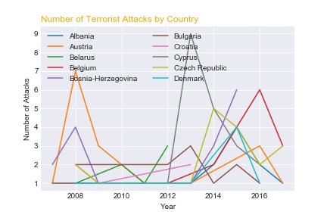

Slide 10
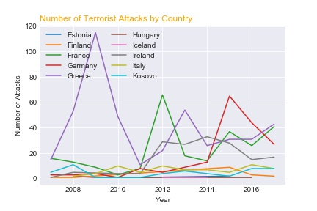

Slide 11


Slide 12
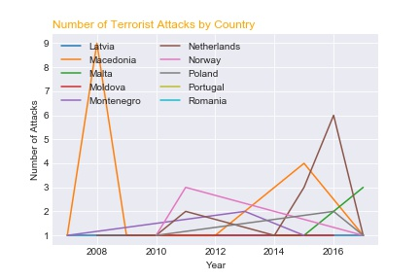

Slide 13


Slide 14
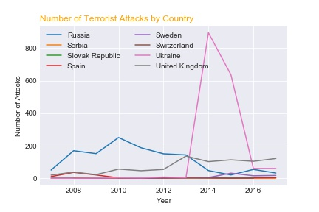

Slide 15
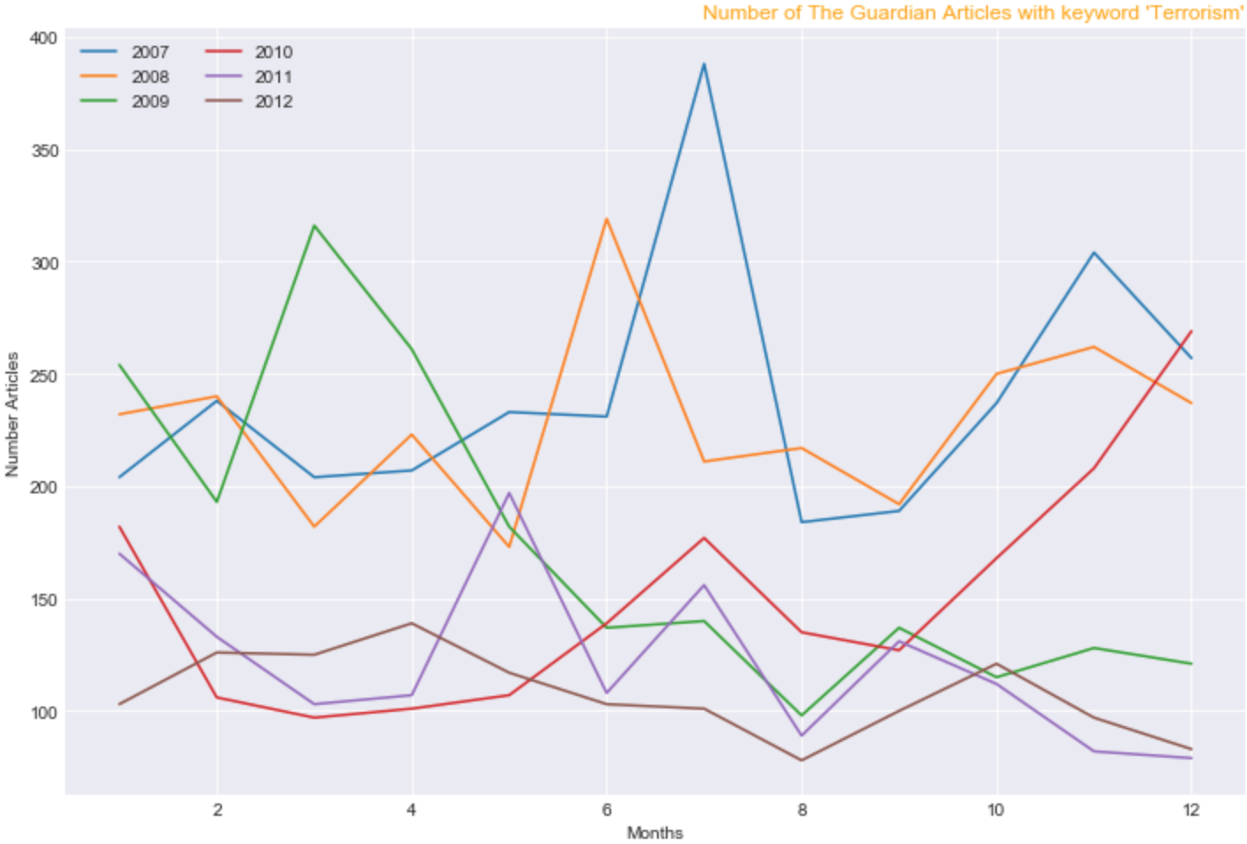

Slide 16
2007 Spike in Articles Written at The Guardian
https://www.theguardian.com/uk/2007/jun/29/terrorism.uksecurity
Two car bombs found in London
https://www.theguardian.com/uk/2007/jul/01/terrorism.world2
Terror threat 'critical' as Glasgow attacked

Slide 17
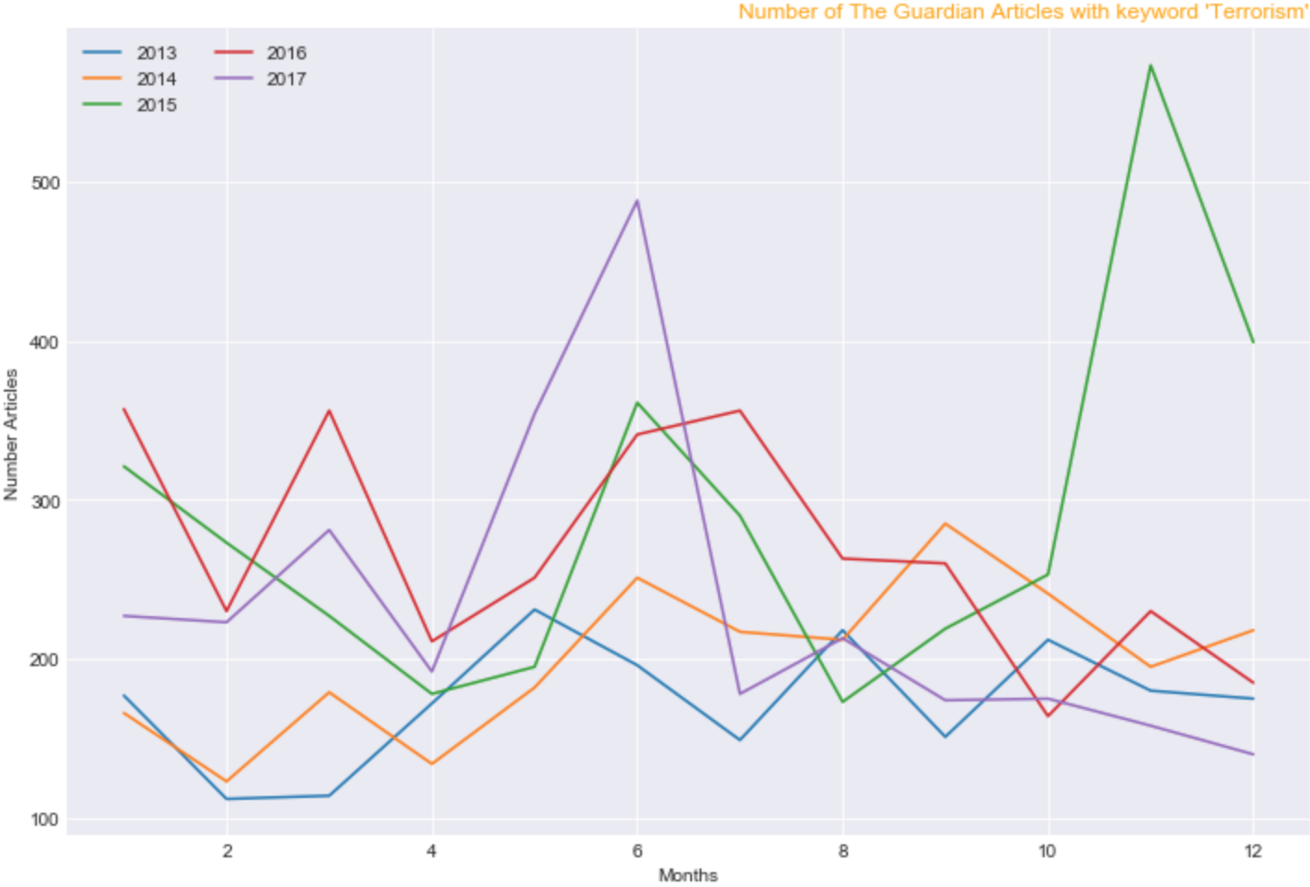

Slide 18


Slide 19
2015 Spike in Articles Written at The Guardian
https://www.theguardian.com/world/live/2015/nov/13/shootings-reported-in-eastern-paris-live
Paris attacks kill more than 120 people

Slide 20
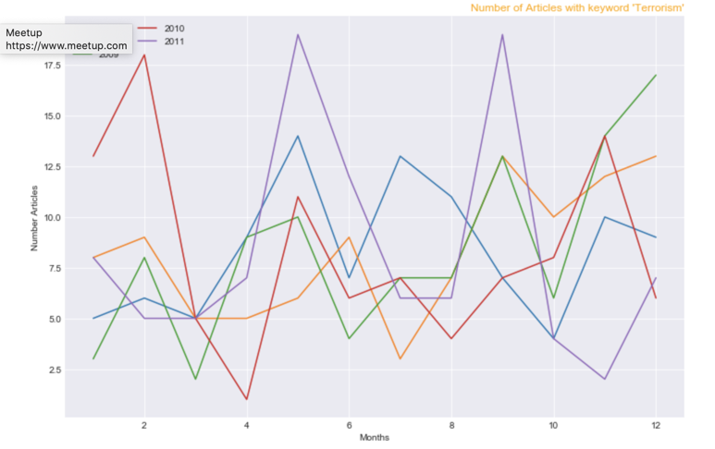

Slide 21
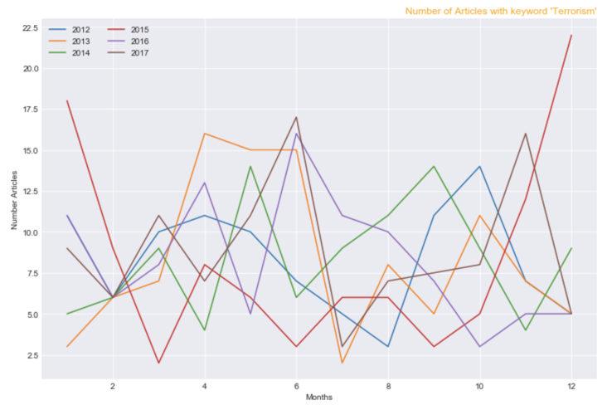

Slide 22
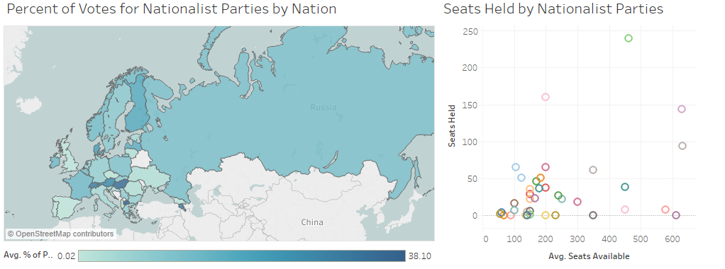

Slide 23
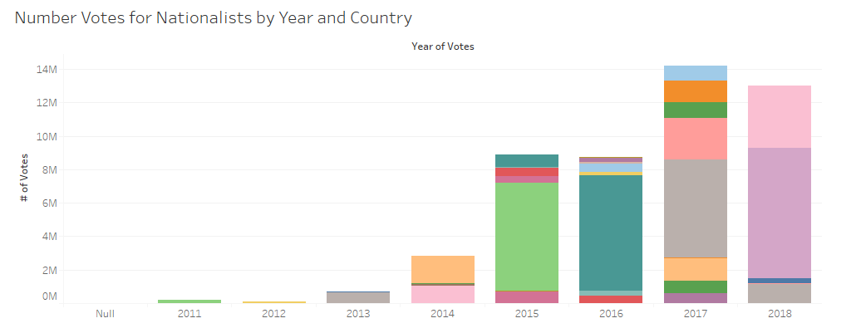

Slide 24
Problems
NY times API
Messy for loop that we had to sort by relevance

Slide 25
